Slide 1
Multimedia Design

Slide 2
Table of Content
Navigational structures
Storyboard
Multimedia interface components
Tips for interface design

Slide 3

When you are done with the planning stage, it is time for you to organize your content.
Computer screens are better suited to show concise chunks of information.
Very long content/pages are disorienting because the user has to scroll long distances and remember what was off-screen.
Organize your information into short categories.

Slide 4
Questions to ask yourself:
What categories should the information be organized into?
What are the priorities for these categories (what is the most important)?
Can I make the chunks of information flow without repeating information?
Are the categories logical and well organized so that the user can predict where to go to find what he wants?
The simplest way to plan and view this flow of information is to draw a flowchart to show how the information will be mapped.

Slide 5
Navigational Structures

Slide 6
Navigational Structure
Linear
Hierarchical
Non-Linear
Composite

Slide 7
Linear
Sequential navigation (sequence of step by step procedures)
They usually go Forward or Backward.
E.g. slides and video presentation

Slide 8
Hierarchical
Based on the logic of the content
Structured through menus and the user makes a choice that leads to another menu.

Slide 9
Non-linear
Navigation is unbound by pre-determine routes.
E.g. website

Slide 10
Composite
Mixed structure
Users may navigate freely, but are occasionally constrained to linear presentations of movies or critical information and/or to data that are most logically organized in a hierarchy.

Slide 11
Storyboard

Slide 12
Storyboard
Storyboarding is literally building a story or sample page on paper that describes roughly the layout.
This is a process lifted from other media development including movie making, cartoon animation and marketing.
A visual representation of the different frames, or screens, that will be included in your production.
The storyboard page is used to describe specific frame of time within a multimedia presentation. It can contain the formatting, layout of the content, layout of the navigational controls, interactivity information and useful comments.

Slide 13
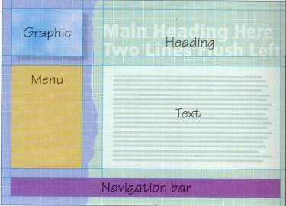
Storyboard
Sample page is drawn on paper to describe the rough layout
Used to describe specific frame within a project.

Slide 14
Title Area
Navigation
Area
Content Area
Sequence No:
Description:

Slide 15
Represent the components
Sketch the components that will be displayed on each screen, including text (rough sketches will do for a first draft).
Add the navigation structure:
draw the buttons,
show the links (e.g. with arrows or numbered screens)

Slide 16
Annotate the drawings:
  show where animations will occur,
  indicate which sound files will play and where,
  add any other effects (transitions, text effects etc.).
Add detail
  add an indication of colour to the background and the text,
  describe text fonts/styles.

Slide 17
Multimedia Interface Components
Background and texture
Buttons, icons and picons
Rollovers and sliders
Hotspots and menus
Feedback

Slide 18

Background and texture

Slide 19
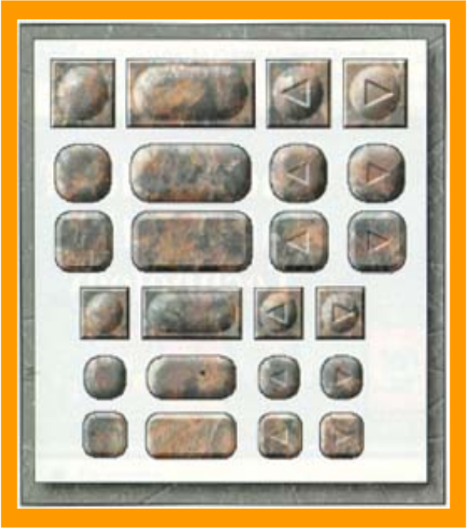

Buttons, icons and picons

Slide 20



Rollovers and sliders

Slide 21

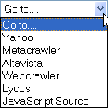
Hotspots and menus
A section of an image which when clicked invokes an action
In one image there can be multiple clickable area.
Menu are used such as pull-down menus usually place on the top or the side area of applications

Slide 22
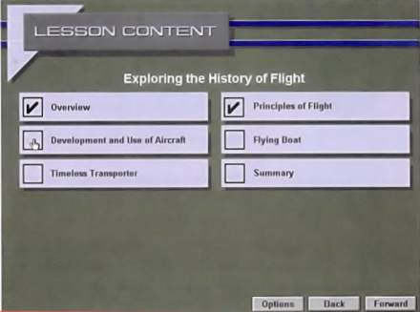
Feedback
Immediate response triggered by user’s action.
E.g. After user answered a question, a pop up window will respond whether the answer is correct or not.

Slide 23
Tips for Interface design
Make sure your information is readable without straining your eyes. Use appropriate background and foreground colors. Do not overuse color and limit the use of strong colors particularly red.
The navigational controls should have indication or visual cues of what are their function.
Make sure users do not have to click too many times to look for specific information.
Do not put too many things/information in one place. It will make the screen too ‘busy’.

Slide 24
Create your interface as simple as possible.
Make sure the size of text and graphics are legible.
Be consistent in the use of symbols and color. Your navigation controls should be at the same place so that users will always know where they are.
Choose clarity over sophistication.

Slide 25
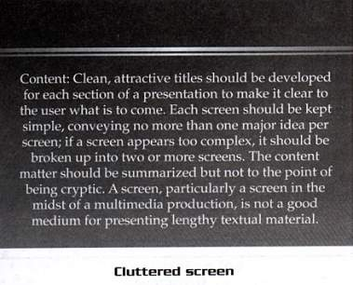
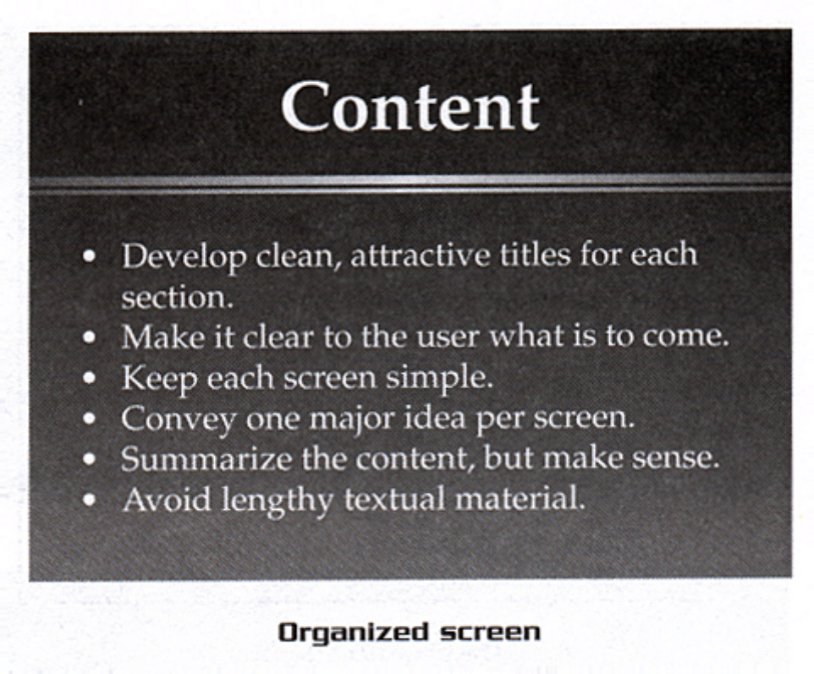
Keep Screen Content Simple and Clear

Slide 26
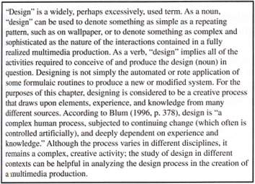
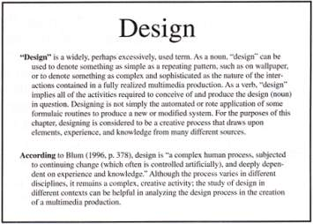
Good use of Margins and White Space

Slide 27
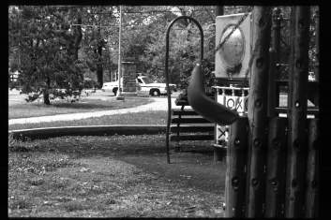
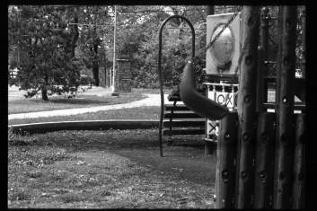
The police car in the top
image has no relevance
in a presentation on
playgrounds.

Slide 28
Avoid Excessive and Improper Use of Color
Uses of Type
Serif type
Ideal for large headlines
Difficult to read in long blocks of text
Looks best when surrounded by lots of white space.
Sans-Serif type
Works well in smaller sizes especially in body text
Looks busy and cluttered in large size.
Uses of Type
Serif type
Ideal for large headlines
Difficult to read in long blocks of text
Looks best when surrounded by lots of white space.
Sans-Serif type
Works well in smaller sizes especially in body text
Looks busy and cluttered in large size.

Slide 29
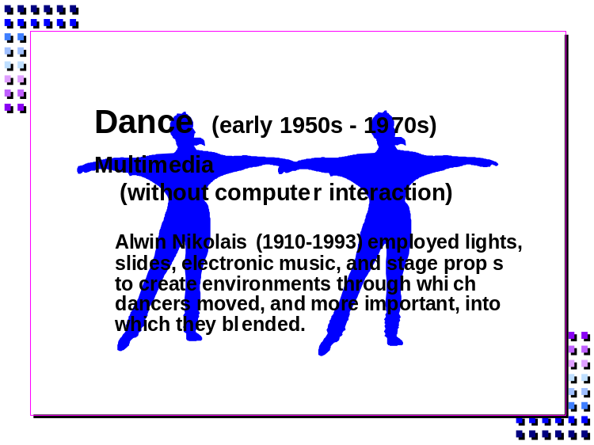
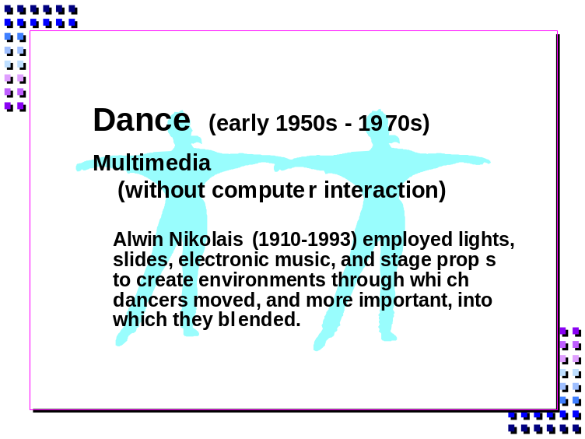
An image should not distract from the main message on the screen
Obtrusive images
Unobtrusive images

Slide 30

Make sure there is enough contrast between foreground and textured background
User will not be able to read this easily
User will be able to
read this easier

Slide 31

Careful use of special effect.

Slide 32
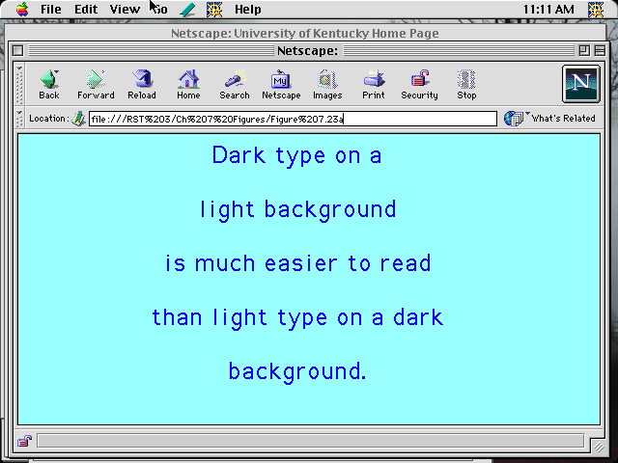
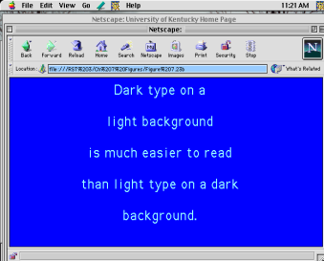
Use Dark Type on a Light Background
Easier to read
Harder to read

Slide 33
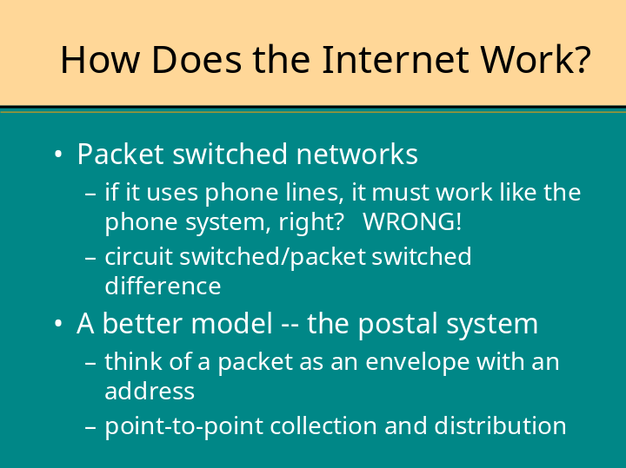
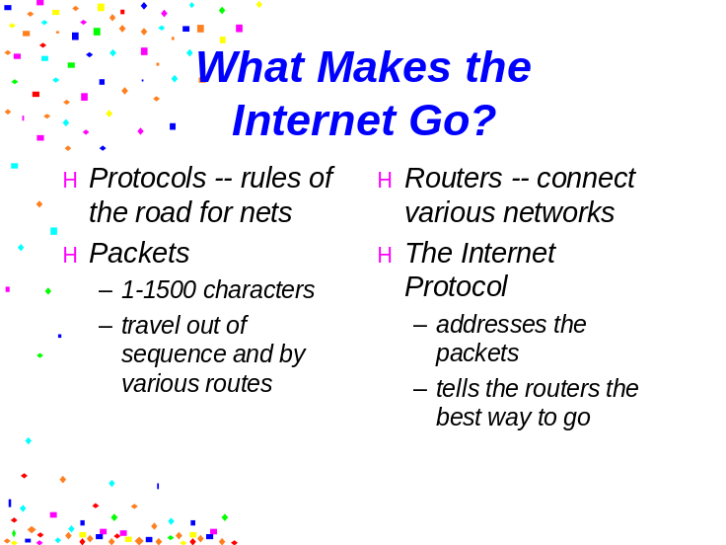
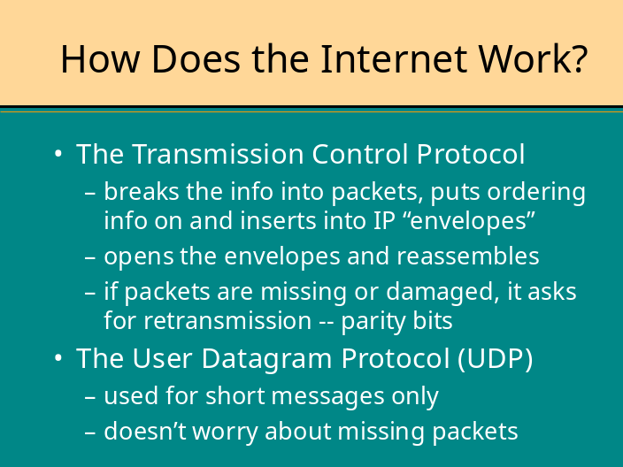
Employ Consistent
Layouts for
Related
Materials
Don’t
Change
Formats in the
Midst of a Concept

Slide 34
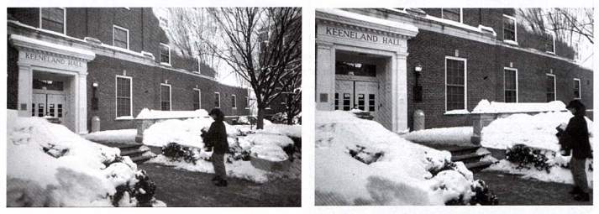
Use Effective Cropping and Image Placement
Uncropped image
Most of the trees and part of
the building are cropped,
emphasizing the student

Slide 35
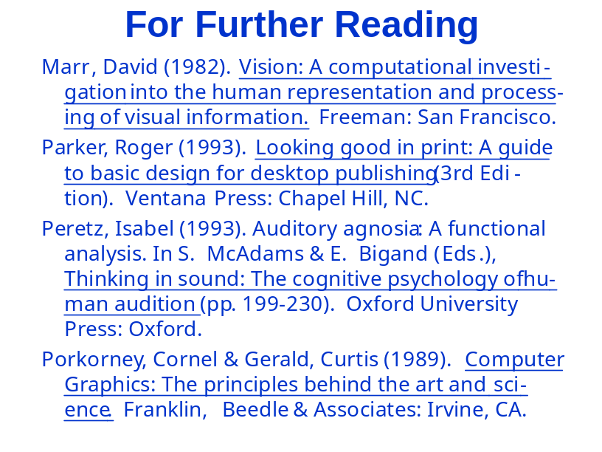
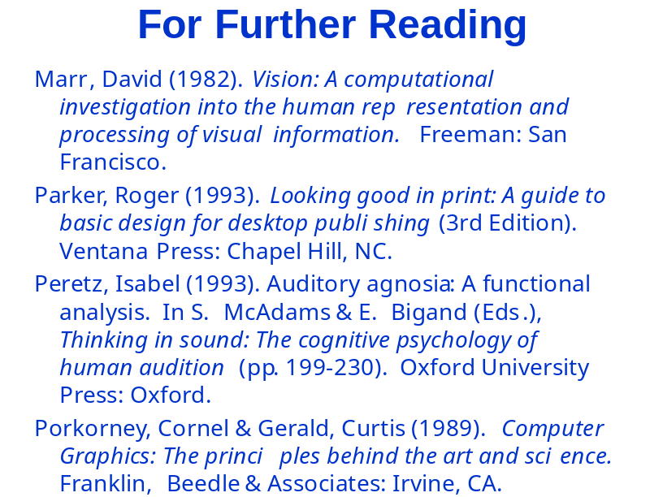
Avoid Hyphenation
and Underlines
Underlined and hyphenated
Clear

Slide 36
Summary
Navigational structures:
  Linear
  Hierarchical
  Non-Linear
  Composite
  Storyboarding is literally building a story or sample page on paper that describes roughly the layout.
  Multimedia interface components:
Background and texture
Buttons, icons and picons
Rollovers and sliders
Hotspots and menus
Feedback

